Slide 1

Prepared by group 3
Group Project
Movie Data Analysis

Slide 2




Group Members
Lorena Terah
Leader
Sharon Kipruto
member
Salma Mwende
member
Edgar Owuor
member
Stephen Musyoka
member
Dawa Jarso
member

Slide 3




Introduction
This project involves conducting an in-depth analysis aimed at generating actionable insights for stakeholders in the movie business.
The analysis will explore various aspects of the movie industry, including financial performance, audience reception, and market trends. Our goal is to equip stakeholders with a comprehensive understanding of key metrics and trends, enabling them to make informed decisions that drive the company's growth and success in the competitive movie market.

Slide 4

Problem objectives
Identify types of films that are performing the best.
Explore and analyze current box office trends.
Identify factors that contribute to the success of a
movie.
4.Translate findings into actionable insights.

Slide 5





DATA QUESTION TO BE ANSWERED
Top-Performing Films:
Characteristics: Traits contributing to high box office gross. Financial Success: Movies with the greatest financial success.
Popular and Successful Genres:
Trends: Popular and successful genres over time.
Audience Preferences: Content that resonates with target audiences based on ratings and reviews.
Impact of Budget on Revenue:
Budget vs. Revenue: How movie budgets affect box office revenue.
Profitability: Can smaller budget films be profitable? Identifying an optimal budget range.

Slide 6

DATA SOURCES
1.Box Office Mojo
Tracks box office revenue data
Analyzes financial performance of films
2. IMDb (Internet Movie Database)
Provides info on movies, TV shows, and entertainment industry
Includes cast/crew, plot summaries, reviews, and ratings
3.Rotten Tomatoes
Aggregates critic and audience reviews for movies and TV
shows
Measures overall reception via percentage scores
4.The Movie DB (TMDb)
User-driven database for movies, TV shows, and celebrities
Offers cast/crew info, plot details, ratings, and reviews
5.The Numbers
Provides detailed box office and financial data
Includes budgets, home video sales, and industry statistics

Slide 7




Data Exploration and Cleaning Process
Familiarizing with the Datasets:
Explored various datasets and analyzed their columns.
Data Cleaning Methods
Handling Missing Values:
Identified and managed missing data through imputation or removal.
Data Transformation:
Converted data types and standardized formats for consistency.
Removing Duplicates:
Checked for and removed duplicate records to ensure data uniqueness.
Outlier Detection:
Identified and handled outliers using techniques such as z-score and IQR method.

Slide 8
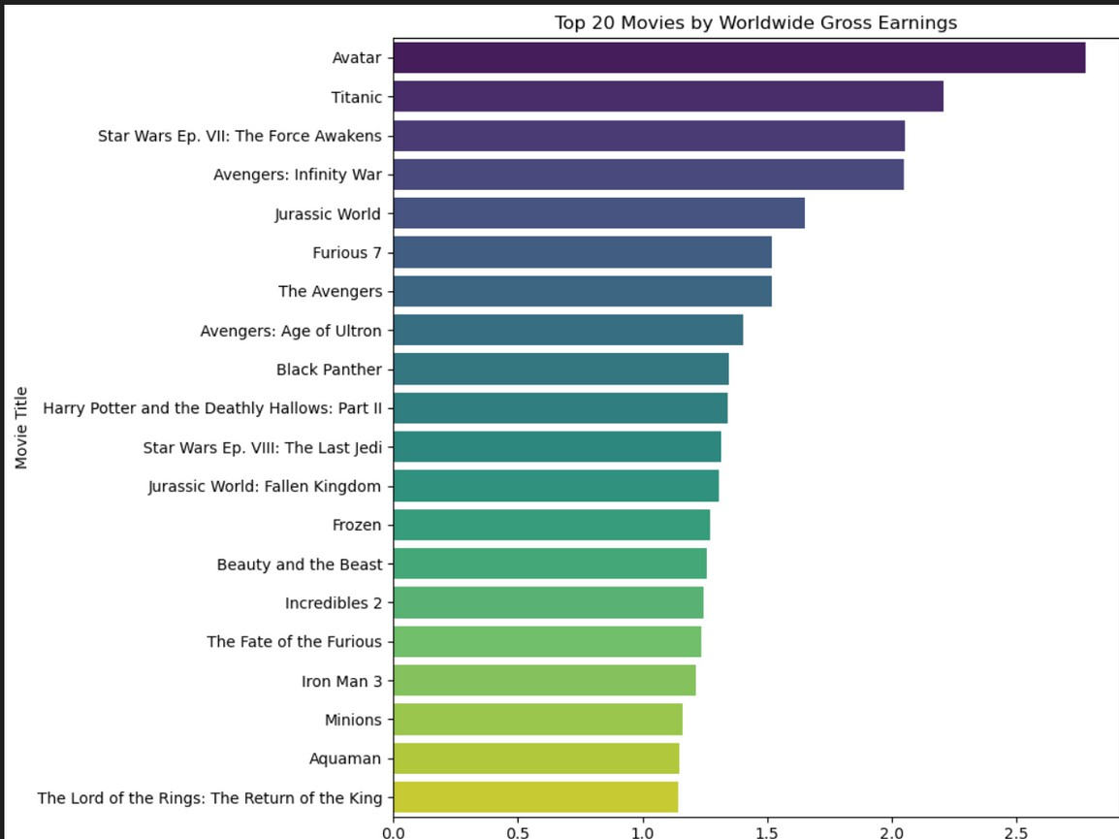

Data Visualization Results
Top 20 movies by worldwide gross earnings
The top three movies by revenue are Avatar with approximately $2.8 Billion followed by Titanic at $2.2 Billion and Star Wars with
$2.0 Billion

Slide 9

Data Visualization Results
Distribution of Genres
The genres with the most distributed is Drama followed by Documentary and Comedy

Slide 10
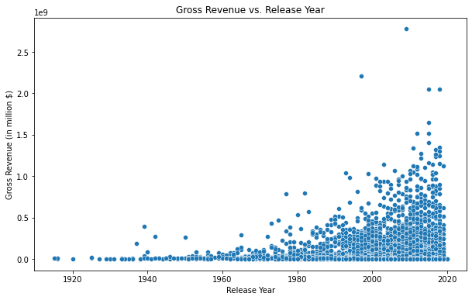
Data Visualization Results
Gross Revenue vs Release year
The plot above shows an that the gross revenue from movies has generally increased from 1920 to 2020. This suggests that movies release in later years tend to earn more revenue.

Slide 11
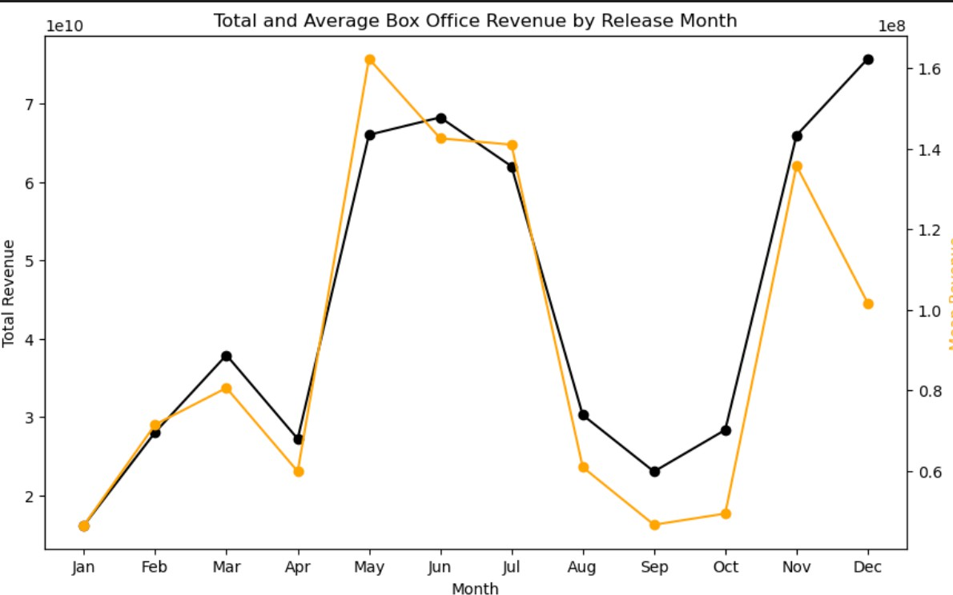
Data Visualization Results
Total revenue release by Release month
The ideal months to release movies are:
May has the highest average worldwide gross earnings, June and then July
* These months could be considered the best time to release a movie for maximum revenue as they generate the highest worldwide gross revenue on average.
December has the highest total revenue

Slide 12
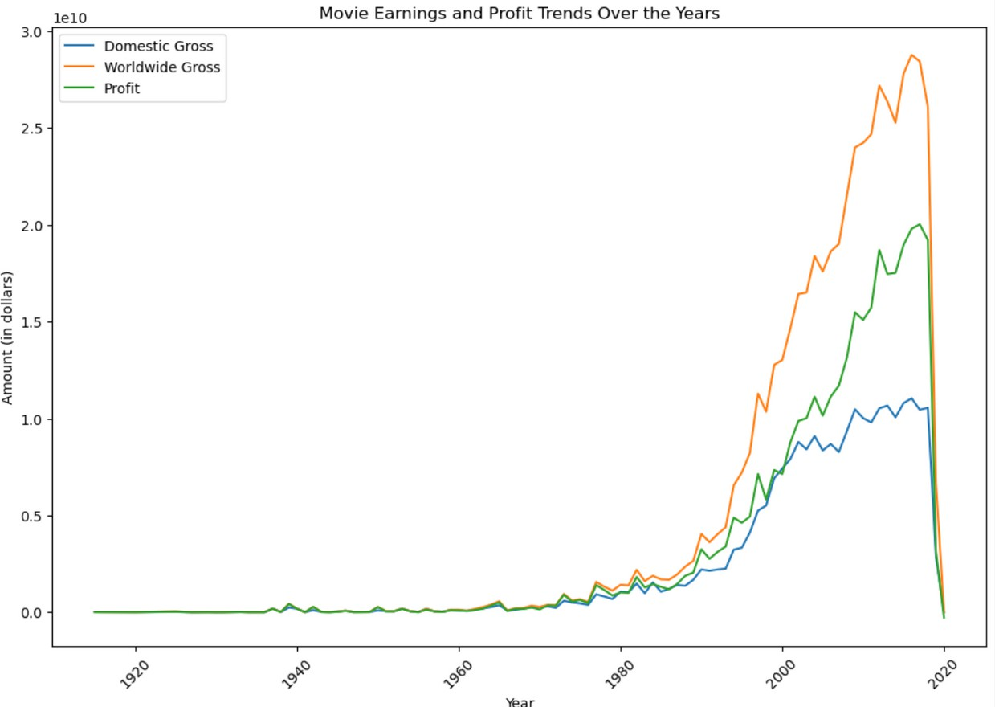
Data Visualization Results
Movie earnings and profit Trends over the years
Over time, we notice
`domestic_gross`, `worldwide_gross` and `profit` have been generally increasing.

Slide 13
Recommendations
Focus on Action, Adventure, Animation, Comedy, Drama, Fantasy, Horror, Romance, Sci-Fi, and Thriller genres, since they are the most profitable
2. Prioritize Action movies, as they are the most popular, since the top 5 popular movies are
from the action genre
3. Target mid-range budgets for optimal ROI and prioritize international appeal in story and
marketing.
4. Schedule movie releases in May, June, July, November, or December, since movies
released in these months shown greater revenue
5. Tailor campaigns for domestic and international audiences separately and leverage high
ratings when available for genres like Documentary or Drama.

Slide 14

Thank you

